Slide 1
INFM 600 Final Presentation
Team 3: Gaurav Hasija, Kayla Covington, Mary Dalrymple, Corie Brown, Tsion Zewolde

Slide 2

Introduction
We understand the difficulty that comes with searching for a job and ensuring you have the appropriate qualifications and experience for a possible career. Students will often ask, “How am I going to use this material in the real world? When will I see this material again in the real world?” Our team has decided to address these common questions and create a tool for students to see job opportunities based on the courses they take.
Notes:
When am i going to apply the skills that i’ve learned in class to the real world?
What can i do in this class to apply the skills to in the jobs that i want?
How can i start planning out my future class schedules to match what i want to do when i graduate?
How i can shape my curriculum and projects to my career goals?

Slide 3
Project Overview
This service would be provided in the form of easy-to-understand Tableau reports, designed for
easy use by academic advisors and students in planning courses. A user could examine the
data from both sides to answer the questions, “How does this course relate to the trending job
market?” and “How could I prepare for this trending job with the courses being offered?” Online
accessibility would be the best way to put this service into use because it would be accessible to
a majority of students on campus. Any student with Internet access has access to this tool.
We expect the outcome of this information service to help students better understand the job
outlook and trending jobs related to their education curriculum and educational interests, and
therefore make better-informed choices. In addition to the benefit of steering students toward
courses related to trending jobs, this service can also pinpoint occupations with high
compensations, as well as roles that are steadily declining.

Slide 4
Introduction to the Data Sources
For this new information service we used the course lists provided by an academic advisor at University of Maryland College Park. In correlation, we also used BLS (Bureau of Labor Statistics) data files to find the corresponding job occupations, salary, and experience needed for those given occupations.

Slide 5
BLS Data
BLS Annual Occupational and Wage Estimates
Used to extract median annual wage, percentile distribution of annual wages
BLS Occupational Projections
Used to extract expected new job openings 2019-2029, typical education required, work experience in related field required, self-employment rates, factors affecting employment

Slide 6
iSchool Data
UMD iSchool Courses Offered Fall 2019 - Summer 2020
Used to extract course codes
Manually matched course codes to course descriptions and relevant occupations

Slide 7
Data Preparation
STEP 1 STEP 2 STEP 3
Vision & Data Collection
Data Pre-Processing
Exploration and insights
Reading various literature and papers to envision the service and identify the data we want to collect for our service.
Exploring identified data sources and narrow down on major ones.
From the data collected, finalising the unifying vision of the service and identifying the environments
Major: Manually mapping iSchool courses with collected BLS data job titles.
Cleaning the Wage data and projections data to get rid of unwanted features.
Null values were filled or removed as requirements.
Creating hierarchy in the data to enable aggregation.
Exploratory analysis is performed and most prominent observations are identified.
Aggregation is performed to provide user with comprehensive view of the data in long-term.
Visualizations are developed to support the intended users decision.

Slide 8
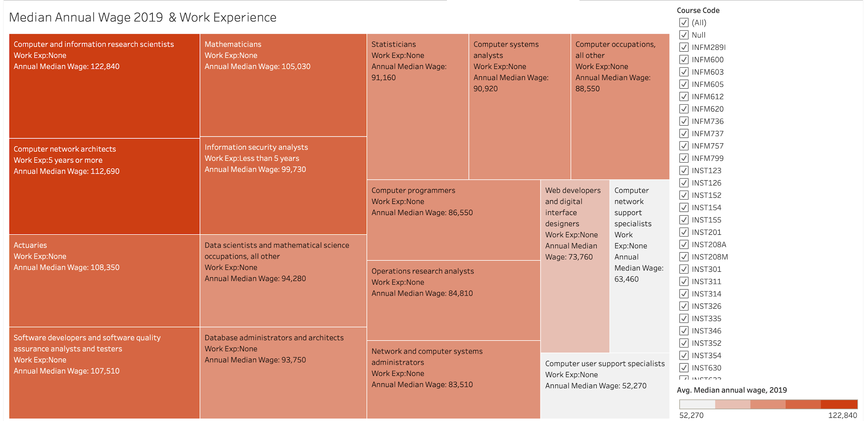
Tableau Report: Median Annual Wage 2019 & Work Experience
Notes:
Speaker Notes: This tableau report is comparing the annual wage to the work experience required for these particular occupations. These occupations are tied to the courses in the Ischool; the occupations for those particular courses. The key is highlighting that darker orange is a higher annual wage, and as the colors get lighter the median annual wage decreases. This chart also compares the work experience required for these occupations. For some occupations such as the “Computer and information research scientists” there is no work experience required but that occupation makes the highest annual median wage.

Slide 9
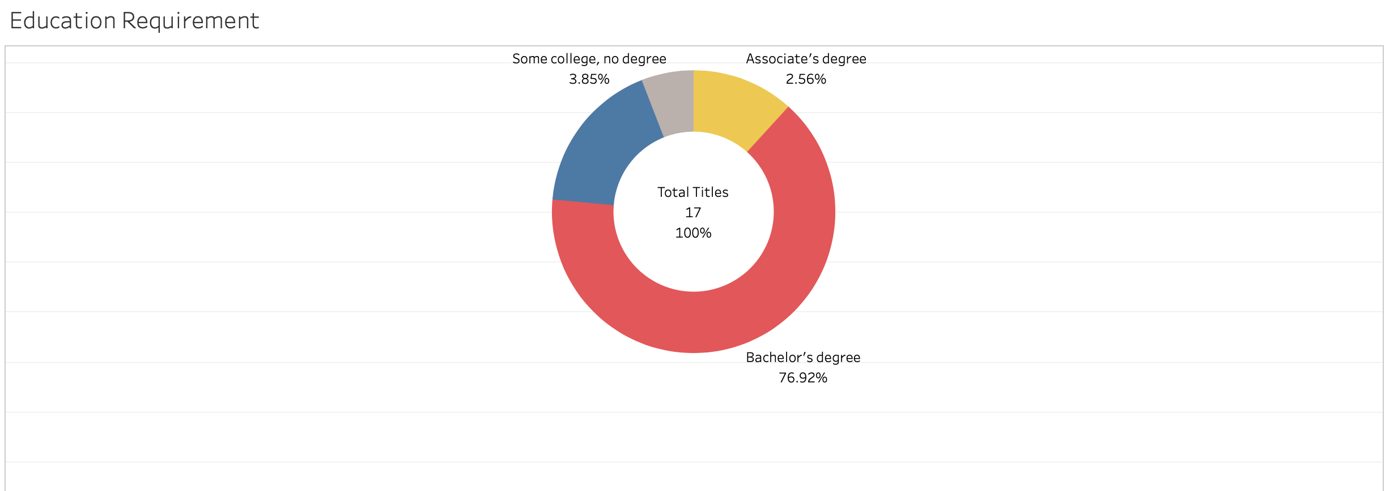
Educational Requirement
Bbas
Based on this tableau report, it is showing the reader that 76.92 percent of these occupation titles require a bachelor's degree. There is a 16.67 percent that requires Masters degree for the specific job title. While 3.85 percent require some-to-none college degree; 2.56 percent require an Associate degree.

Slide 10
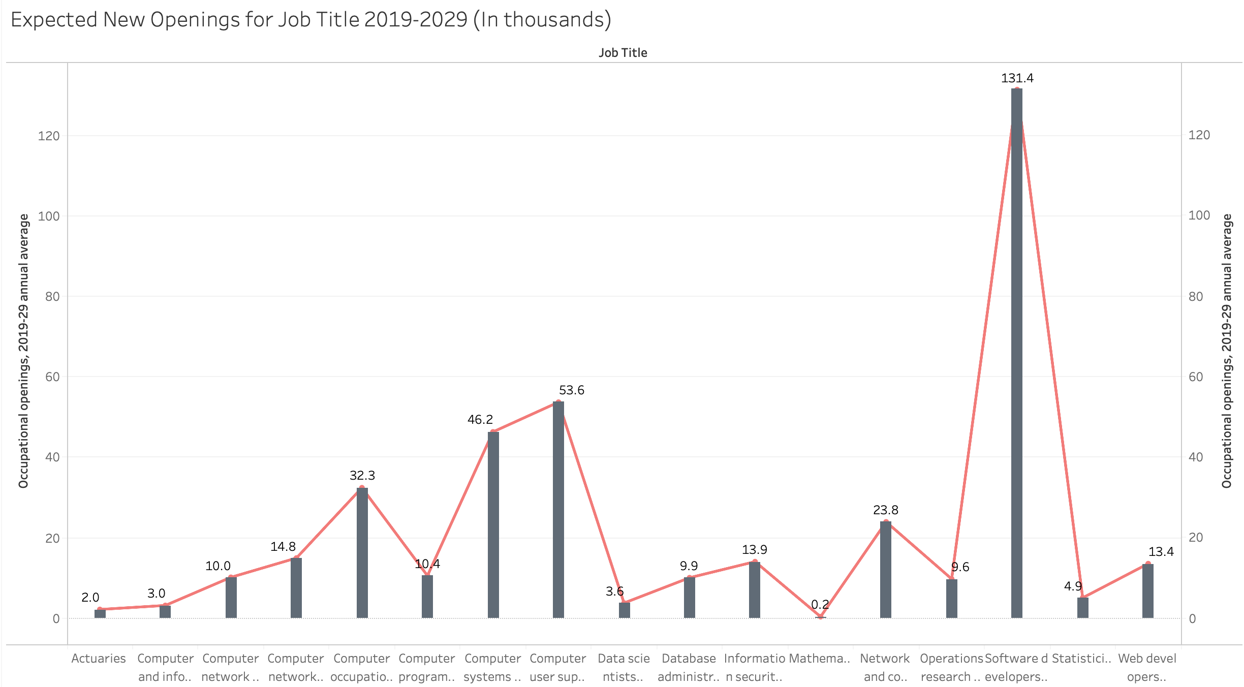
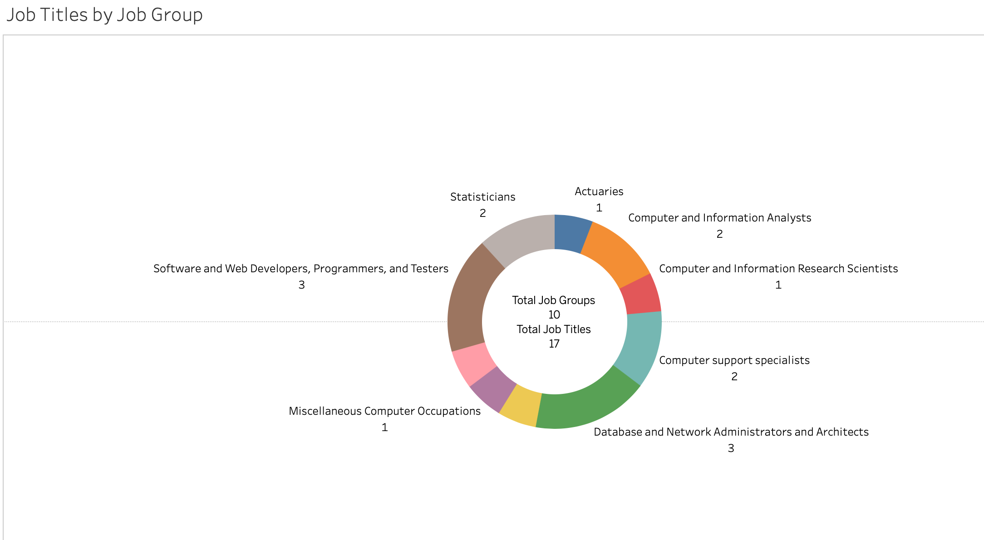
Tableau Report
There were 17 job titles, grouped into 10 groups. The chart to left is projecting the expected new openings within these job titles from 2019-2029. The numbers above the chart are a description of the amount of jobs that will be open within that given title for the expected years (2020-2029).

Slide 11
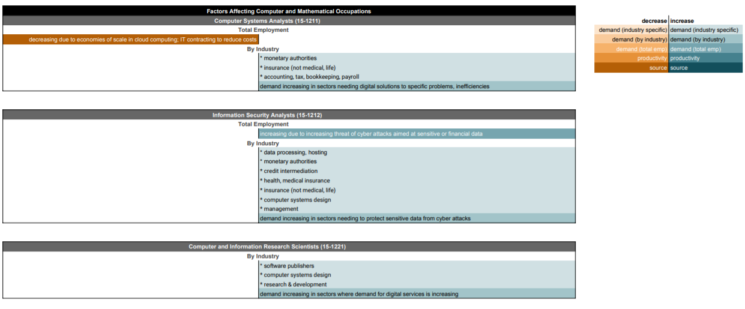
Factors Affecting Occupations

Slide 12
Thank You

